Slide 1

ZEN FITNESS ZONE TRACKER

Slide 2
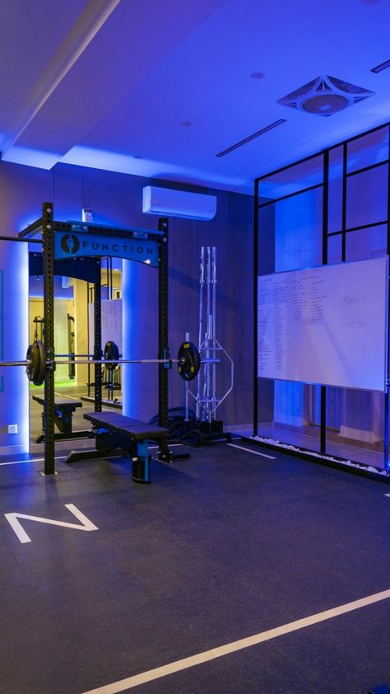
TABLE OF CONTENT
ABSTRACT
INTRODUCTION
REQUIREMENTS
FLOW DIAGRAM
EXISTING SYSTEM ADVANTAGES
PROPOSED SYSTEM ADVANTAGES
MODULES
IMPLEMENTATION
OUTPUT SCREENSHOT
FUTHURE ENCHANCEMENT
CONCLUSION

Slide 3

ABSTRACT
Holistic Approach: The project focuses on a comprehensive method for personal fitness and wellness.
The Key Aspects are Calorie management , Hydration tracking , Workout routines , Heart rate monitoring , Exercise analysis.
Optimization of Physical Activities: Helps users understand and improve their daily exercise routines.
Balanced Fitness Practices: Highlights the importance of maintaining a well-rounded fitness regimen.
Empowerment: Aims to help individuals achieve their health goals effectively and sustainably.

Slide 4

INTRODUCTION
About the App: A web-based fitness application built using HTML, CSS, and JavaScript.
Purpose: Helps users track their fitness goals, workouts, hydration, and calorie intake.
User-Friendly Interface: Designed for easy navigation and accessibility.
Goal: Promote a healthy and balanced lifestyle through digital fitness tracking.

Slide 5

REQUIREMENTS
HARDWARE
SOFTWARE
Laptop/Computer-Intel Core i5 or highest processor,8GB ram and 16GB for smooth multitasking
Networking : Stable internet connectivity to access and test cloud hosting and APIs.
Testing device : Access to different PC and laptop to test cross-platform compatibility.
Frontend : Develop the user interface using HTML,CSS, and java script.
Backend : Javascrpit for server side scripting and APIs to handle data.
Database : Javascript for storing user data.

Slide 6
Signup/Login
Dashboard
Workout Schedule
Workout Pie Chart
Timer/Stopwatch
Exercise Chart
FLOW DIAGRAM

Slide 7

EXISTING SYSTEM ADVANTAGES
Visual Progress Tracking – Charts help users easily understand workout and diet patterns.
User-Friendly Interface – Simple layout with clear sections and neon styling for better focus.
Built-in Timer & Stopwatch – Helps users stay on track during workouts.
Calendar Integration – Allows users to schedule and log workouts effortlessly.
Complete Fitness Coverage – Tracks exercise, diet, water intake, and heart rate in one place.

Slide 8
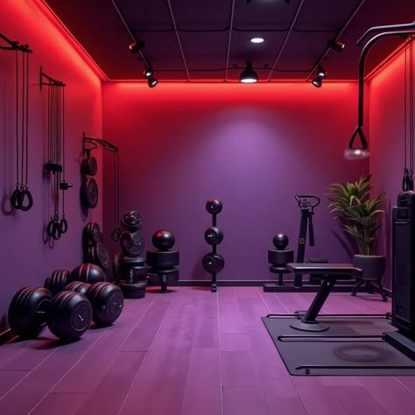
PROPOSED SYSTEM ADVANTAGES
User Login System – Secure and personalized fitness tracking.
Weekly Workout Scheduler – Plan workouts in advance with day and time.
Advanced Analytics – Tracks calories (daily/weekly/monthly) and water intake via graphs.
Editable Workout History – Easily update or delete past entries.
Additional Health Metrics – Includes sleep, steps, food, meditation, and more.
Modern Neon UI – Visually appealing and fully responsive design.

Slide 9

MODULE
Signup
Dashboard
Calendar To Do
Timer/stopwatch
Exercise

Slide 10

SIGNUP/LOGIN:
Allow user to create an account securely.
we can login to access their fitness dashboard.
DASHBOARD:
Display an overview of user.
It shows workout progress ,heartbeat ,calories ,hydration level.
CALENDER TO DO
Help user schedule workouts and manage fitness goals.
Provide a checklist for completed and pending task.
TIMER AND EXERCISE
Include Timer and Stopwatch for different Exercises.
Provide a list of exercise with guided images.

Slide 11

IMPLEMENTATION
1.Frontend Development
Structure content with HTML5.
Style interfaces using CSS3 for intuitive layouts.
Add interactivity via JavaScript for dynamic content.
2.Backend Development
Use javascript for server-side tasks (if needed).
local storage or lightweight databases like Javascrpit for user data.
3.Deployment
Ensure compatibility with major browsers (e.g., Chrome, Firefox, Edge).

Slide 12

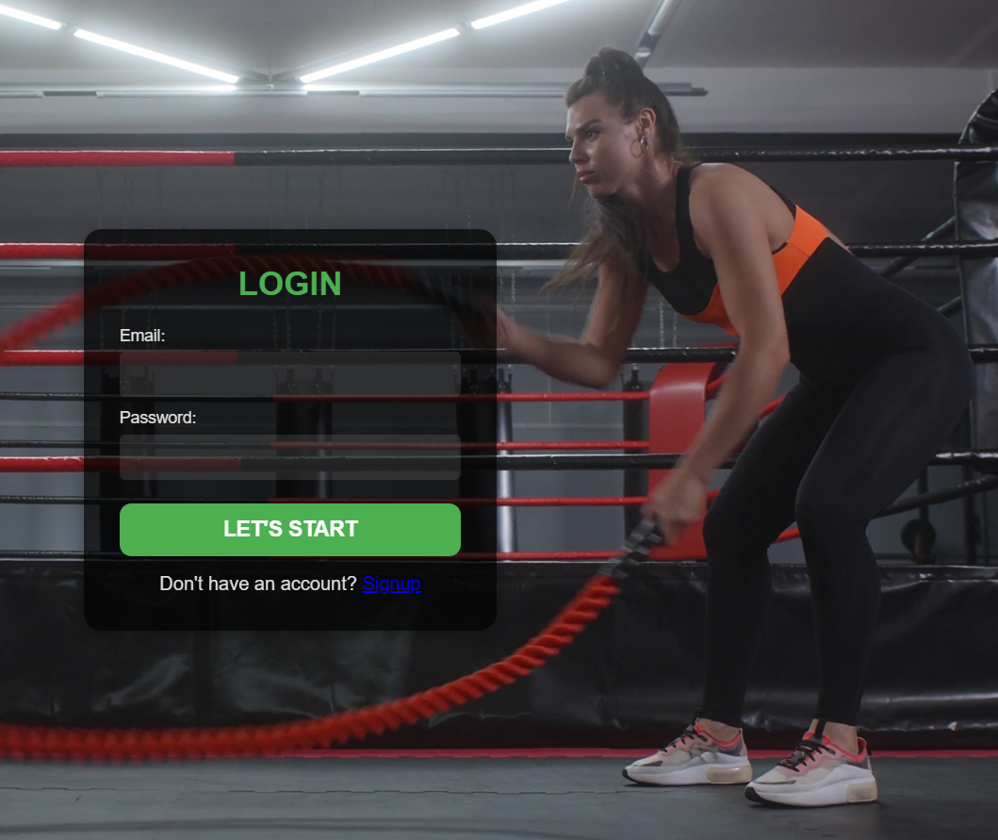
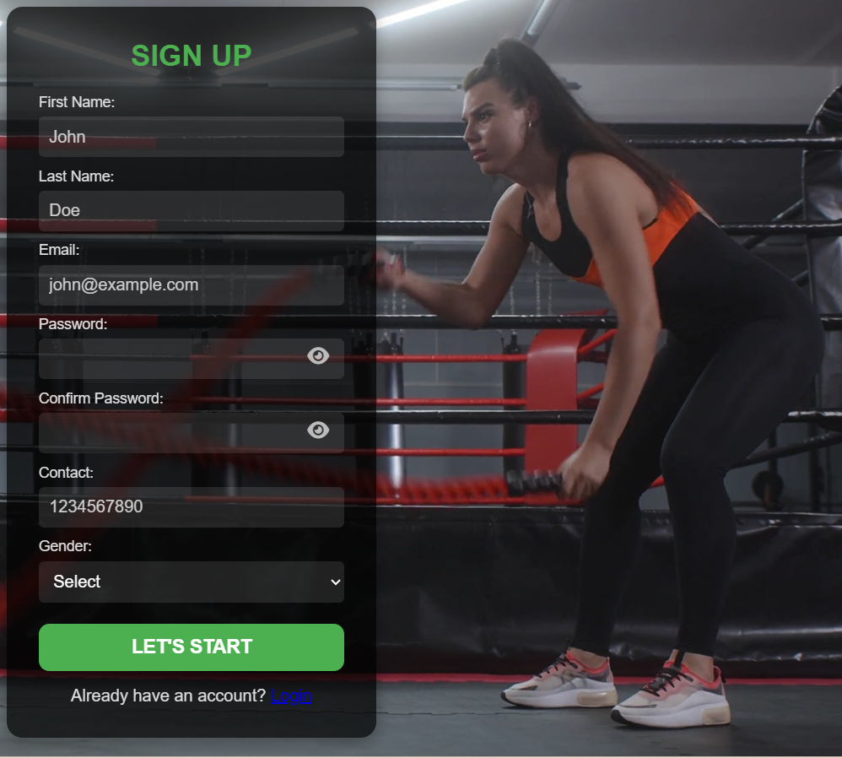
OUTPUT SCREENSHOT
LOGIN AND SIGNUP :

Slide 13

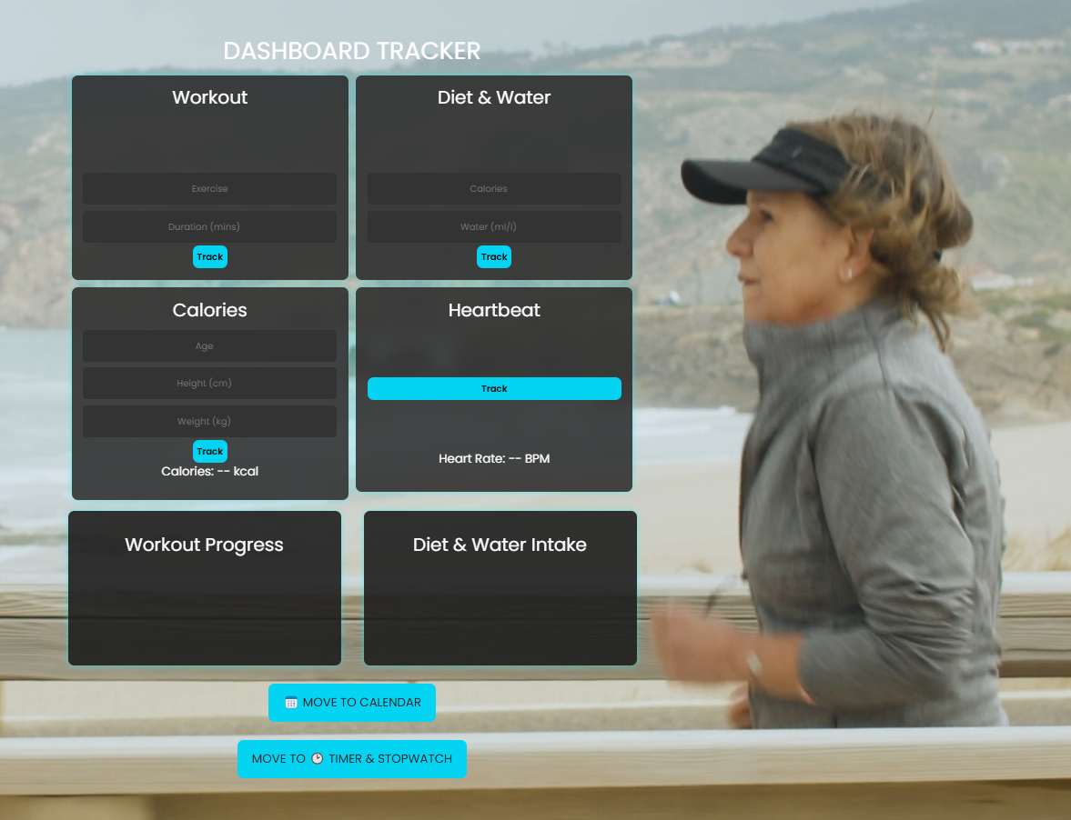
DASHBOARD:

Slide 14

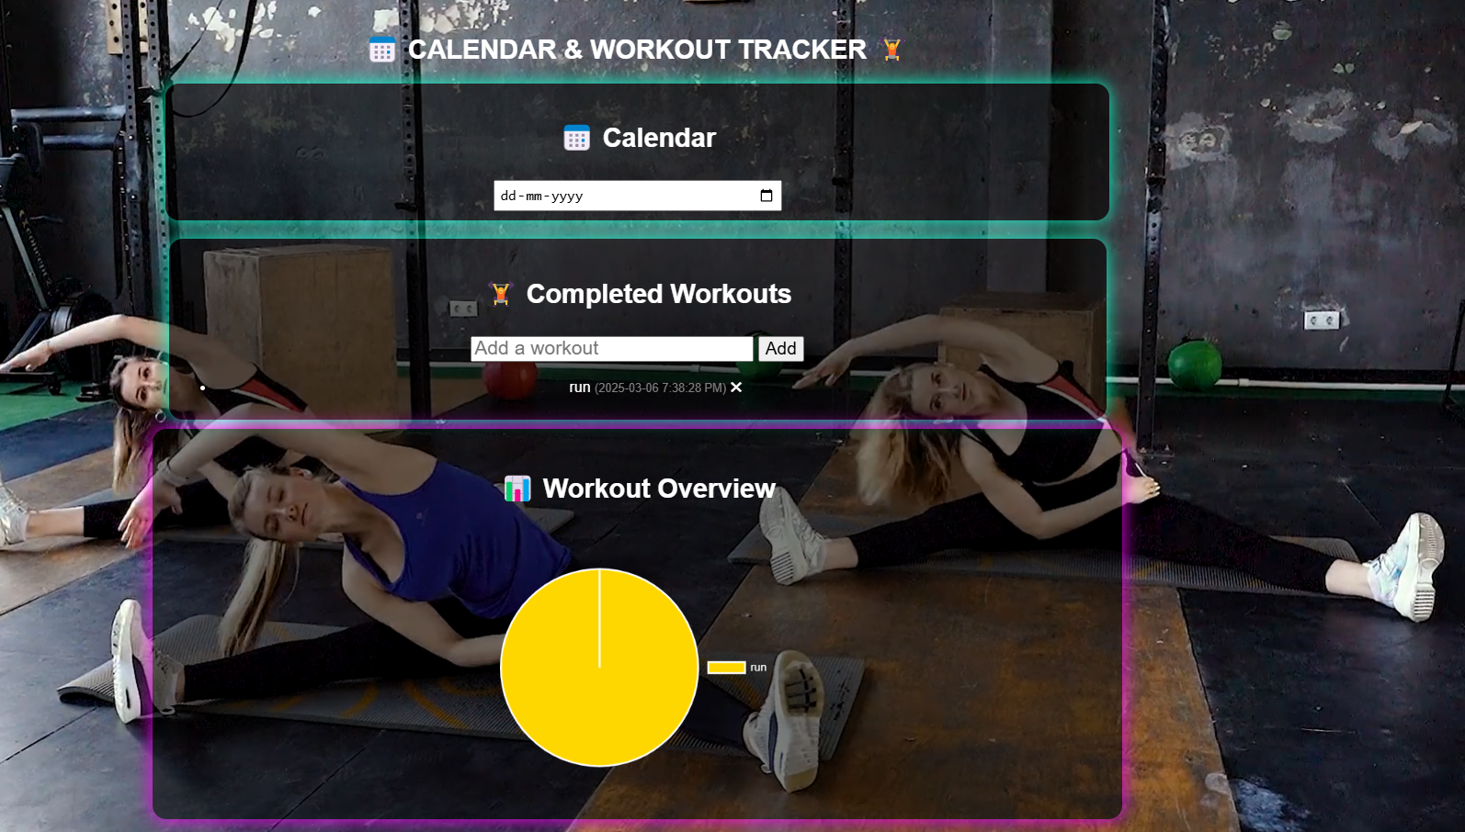
CALENDAR AND TODO LIST:

Slide 15

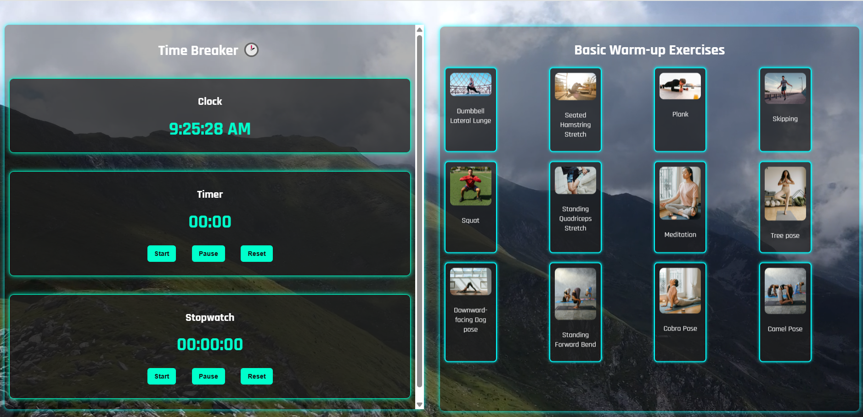
TIMER AND WARM UP EXERCISES:

Slide 16

CONCLUSION
Provides safety guidelines, progress tracking, and nutrition advice for a secure fitness journey.
Promotes stress relief exercises, community engagement, and gamified rewards for motivation.
Integrates with wearable devices for effortless fitness monitoring.
Encourages a lifelong commitment to health and wellness.

Slide 17
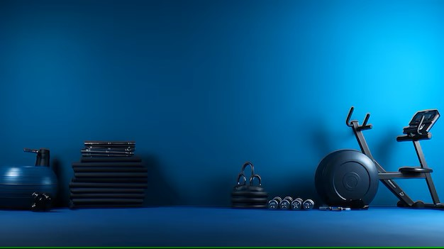
FUTURE ENHANCEMENT
AI-driven tailored plans based on user progress and preferences.
Real-time dynamic workout adjustments for flexibility.
Meal planner with nutrition tracking to complement workouts.
Customized daily reminders to stay on track.

Slide 18

THANK YOU !!!

